Slide 1
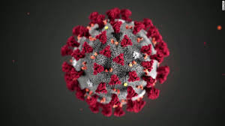
COVID-19 Update
Bonnie Maldonado, MD
March 17, 2020

Slide 2
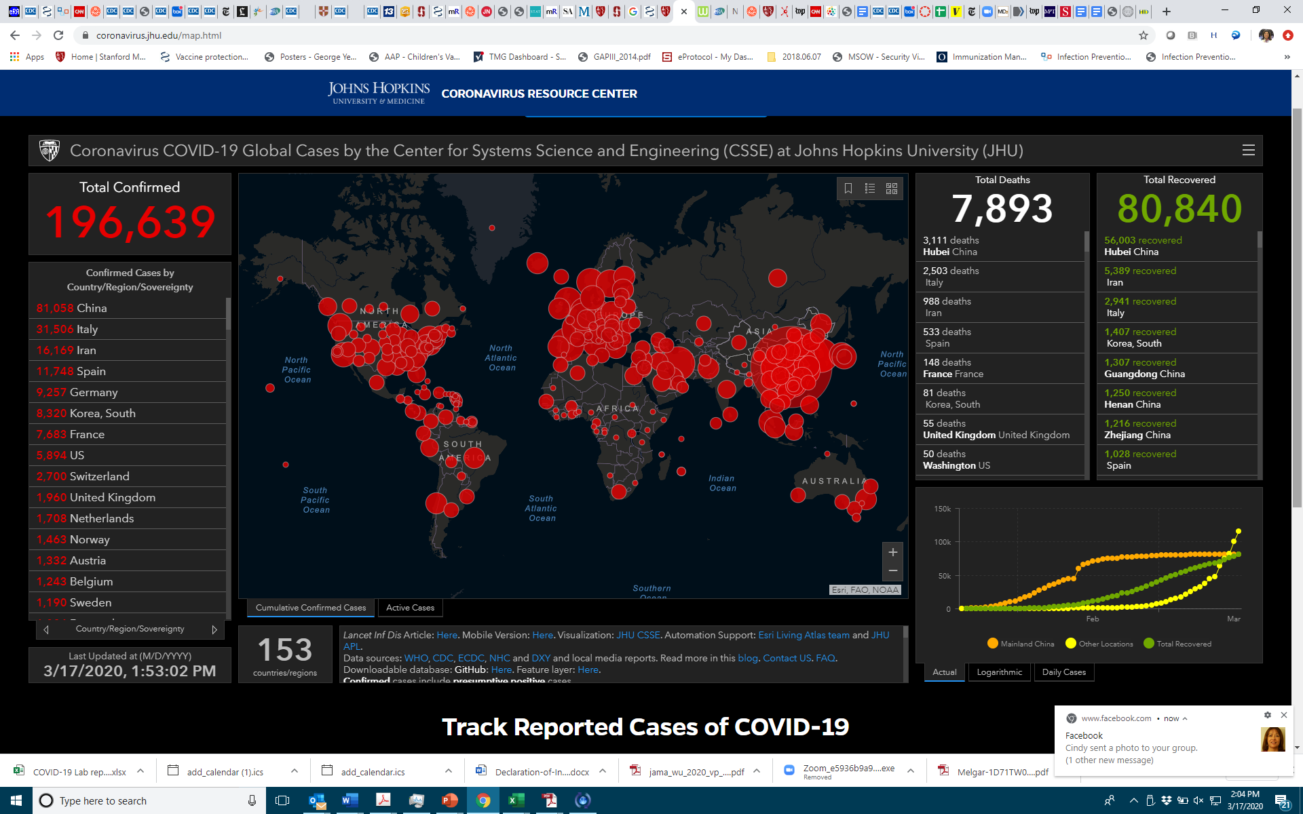
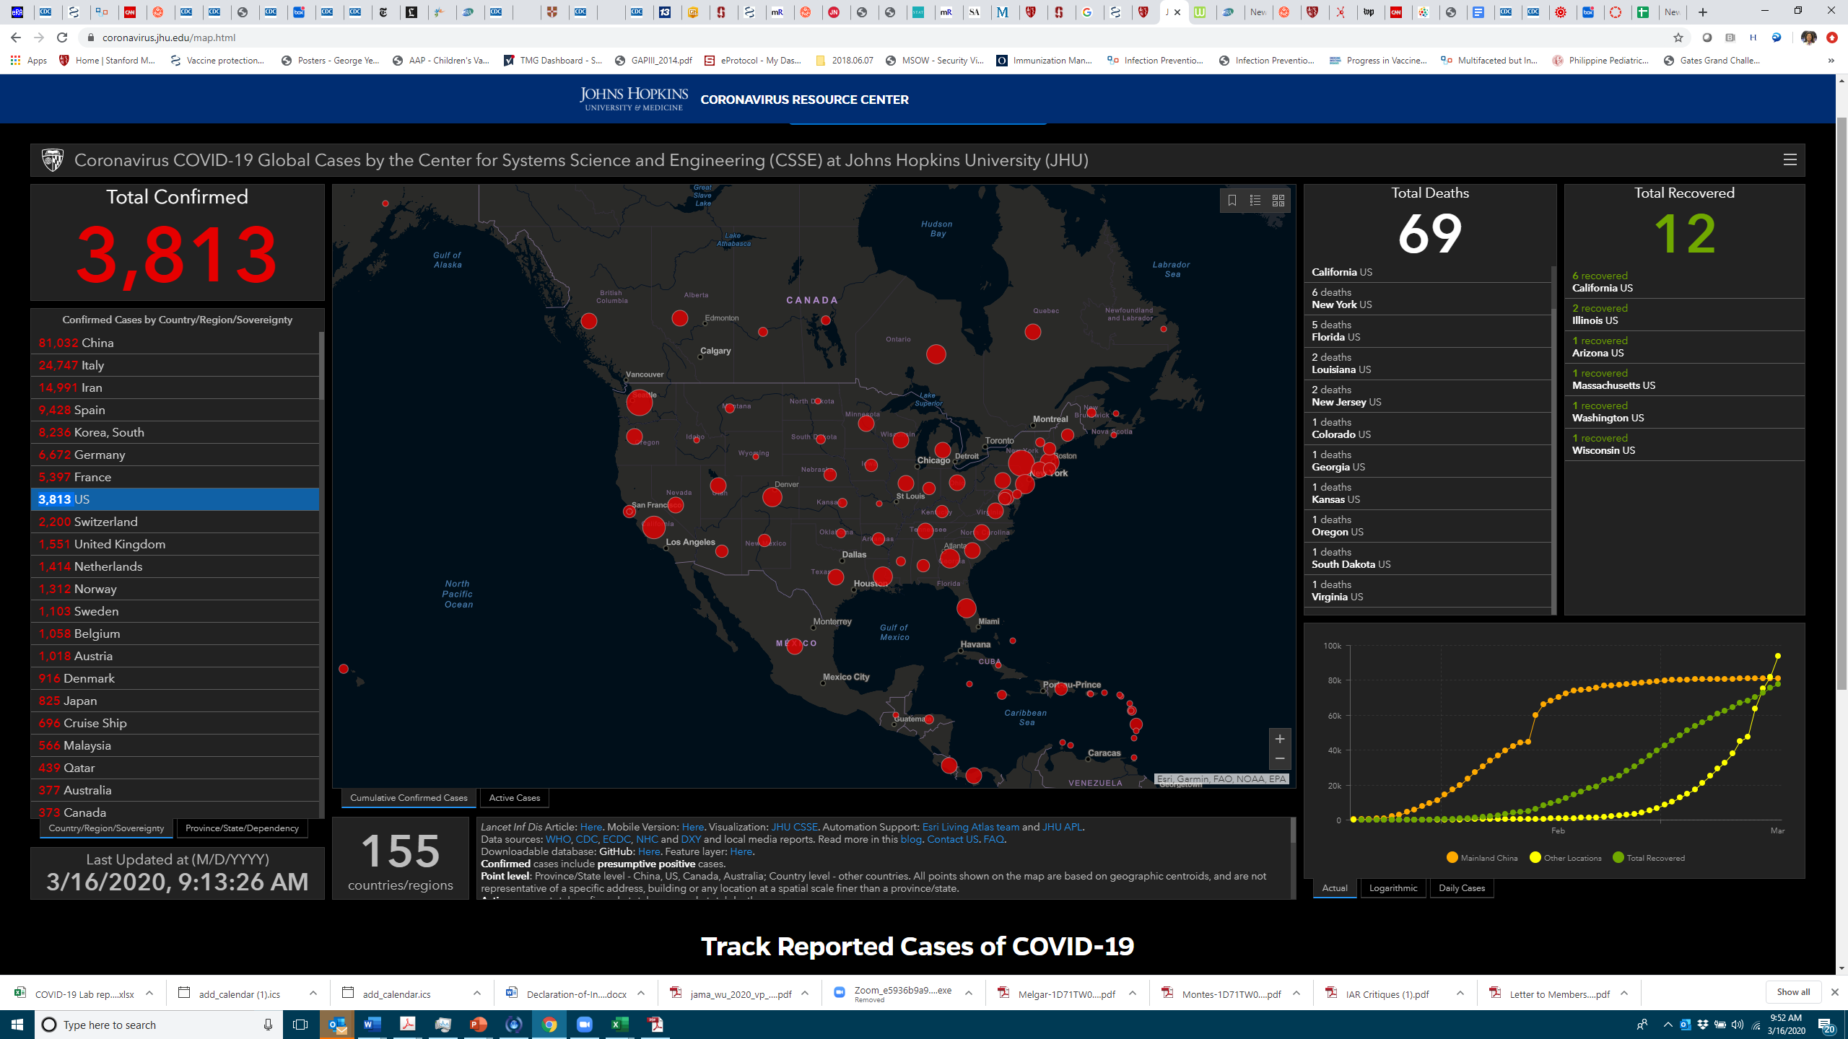
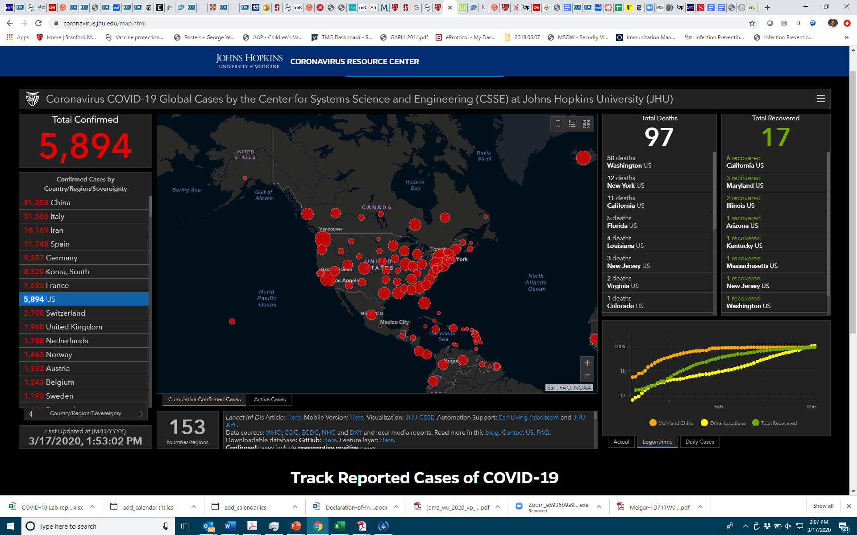
https://www.arcgis.com/apps/opsdashboard/index.html#/bda7594740fd40299423467b48e9ecf6

Slide 3
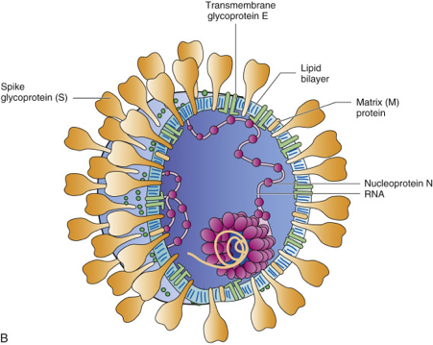
Coronaviruses
Enveloped +RNA virus named for solar corona-like appearance of their virions
Second most prevalent cause of the common cold
Replicate at lower temperatures, thus predilection for upper respiratory tract
The corona helps the enveloped virus survive the GI tract
Control of transmission is difficult

Slide 4
Human Endemic Coronaviruses (HCoVs)
229E, HKU1, NL63, OC43
Up to 15-30% of human colds
No durable immunity – frequent cycles of infection
Upper respiratory infections – most common
Lower respiratory infections – immunocompromised patients
Worldwide circulation
Winter and early spring
No vaccines or antivirals licensed or in use

Slide 5
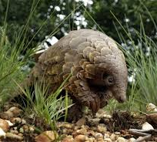
Emerging Coronaviruses
SARS-CoV (2002-2004) – Severe Acute Respiratory Syndrome
> 8,000 cases, 10% mortality, 32 countries in 3 months
Bats → Civet Cats / Racoon Dogs → Humans
MERS-CoV
> 2,500 cases, ~ 35% mortality, 27 countries
Bats → Camels → Humans
SARS-CoV-2
> 100,000 cases, 1-2% mortality, > 140 countries
Bats → Pangolins??? → Humans

Slide 6
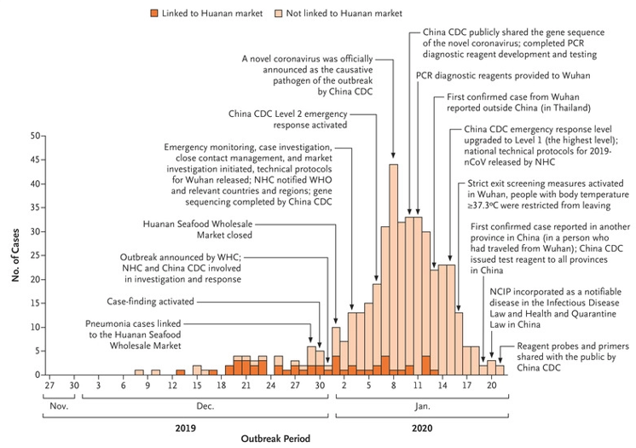
First 425 Confirmed Cases of SARS-CoV-2
Decline after January 8 likely due to delays in diagnosis and lab confirmation
Li et al, NEJM 2020, DOI: 10.1056/NEJMoa2001316
January 29, 2020

Slide 7
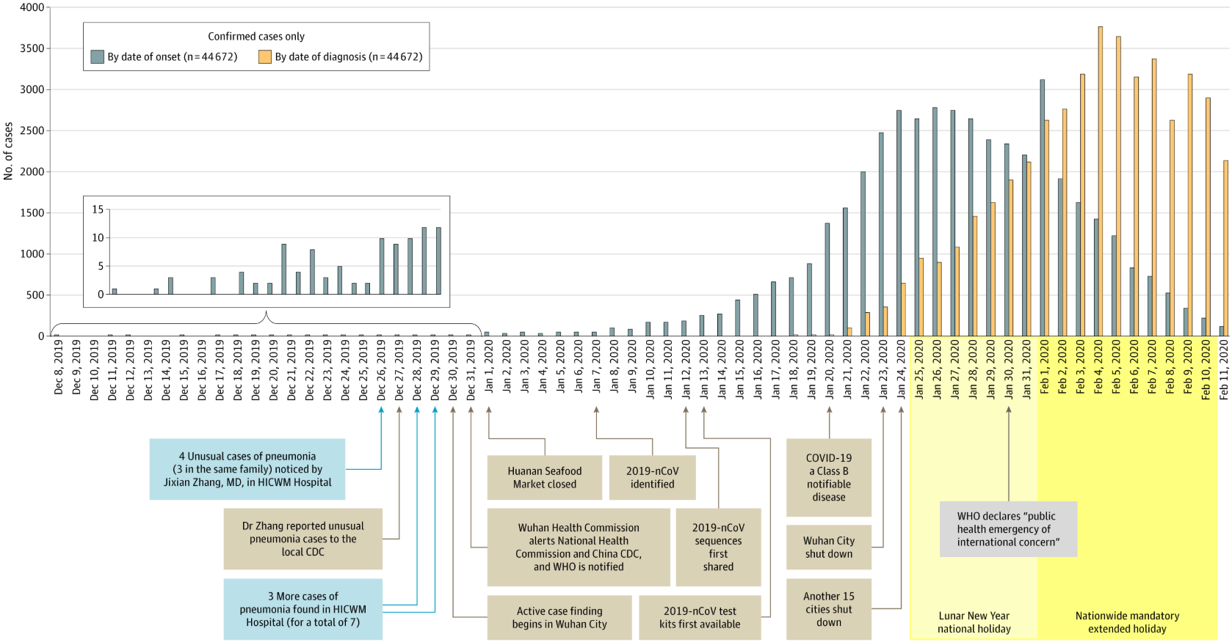
72,314 Cases Reported by Chinese CDC
Wu and McGoogan
JAMA. Published online February 24, 2020. doi:10.1001/jama.2020.2648

Slide 8
COVID-19 Clinical Symptoms
Fever (83-98%)
Cough (46-82%)
Myalagia or fatigue (11-44%)
Shortness of breath (31%)
Less common symptoms: diarrhea, productive sputum
Potential for worsening clinical course during second week of symptoms
ARDS developed in 17-29% of hospitalized patients
Secondary infection in 10% of hospitalized patients
Chen et al., Lancet 2020
Huang et al., Lancet 2020

Slide 9
COVID-19 Disease Severity
36,160 cases (81%) reported mild symptoms
6,168 cases (13.8%) reported severe symptoms
2,087 cases (4.7%) critically ill
Case fatality higher among those with comorbid conditions (2-12%) compared with those with no comorbid conditions (0.9%)
China CDC Weekly Report February 17, 2020

Slide 10
Age of Confirmed Cases in China, 02/11/20
 | Cases N (%)
0-9 years | 416 (0.9)
10-19 years | 549 (1.2)
20-29 years | 3,619 (8.1)
30-39 years | 7,600 (17.0)
40-49 years | 8,571 (19.2)
50-59 years | 10,008 (22.4)
60-69 years | 8,583 (19.2)
70-79 years | 3,918 (8.8)
≥ 80 years | 1,408 (3.2)
China CDC Weekly Report February 17, 2020

Slide 11
Mortality of Confirmed Cases in China 02/11/20
 | Cases N (%) | Deaths N (%) | Case Fatality Rate (%)
Overall | 44,672 | 1,023 | 2.3%
0-9 years | 416 (0.9)
10-19 years | 549 (1.2) | 1 (0.1) | 0.2
20-29 years | 3,619 (8.1) | 7 (0.7) | 0.2
30-39 years | 7,600 (17.0) | 18 (1.8) | 0.2
40-49 years | 8,571 (19.2) | 38 (3.7) | 0.4
50-59 years | 10,008 (22.4) | 130 (12.7) | 1.3
60-69 years | 8,583 (19.2) | 309 (30.2) | 3.6
70-79 years | 3,918 (8.8) | 312 (30.5) | 8.0
≥ 80 years | 1,408 (3.2) | 208 (20.3) | 14.8
China CDC Weekly Report February 17, 2020

Slide 12
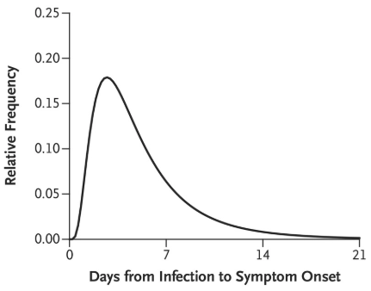
Incubation Time
Li et al, NEJM 2020, DOI: 10.1056/NEJMoa2001316

Slide 13
Reproductive Number
(R_{o}): the rate of spread of an epidemic, and whether such spread is self sustaining, depends on the magnitude of the basic reproduction number
The average number of secondary cases generated by one primary case in a susceptible population.
The effective reproduction number (R_{t}) quantifies the number of infections caused by each new case occurring at time t. This number is lower than R₀ because:
The effect of control measures in reducing transmission
The depletion of susceptible individuals

Slide 14
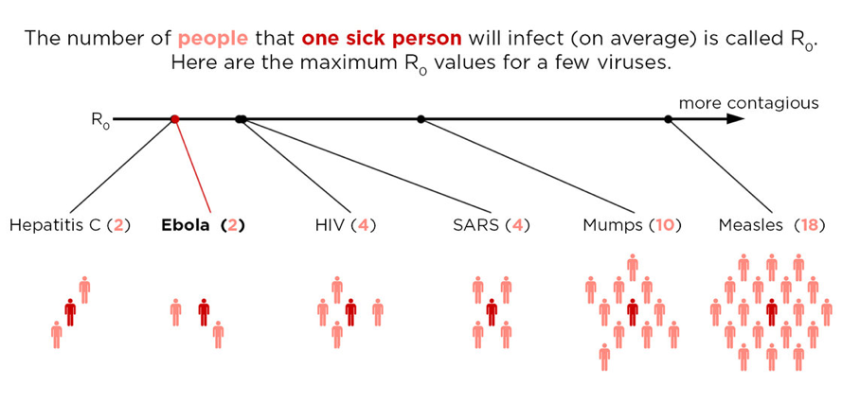

Slide 15
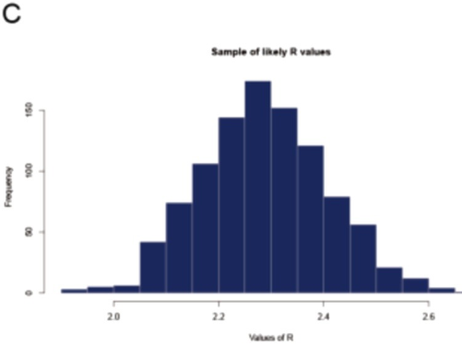
R₀ From Diamond Princess Cruise Ship
R₀: 2.28
(95% CI: 2.06, 2.52)
Zhang et al,
Int J Infect Dis. 2020 Feb22; 93:201-204. doi: 10.1016/j.ijid.2020.02.033

Slide 16
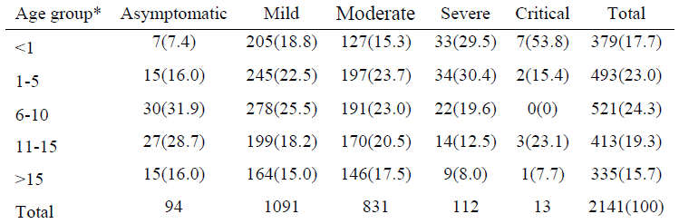
2,143 Pediatric COVID-19 Cases in China
Dong et al., Pediatrics. 2020; doi: 10.1542/peds.2020-0702; Advance Released March 16, 2020

Slide 17
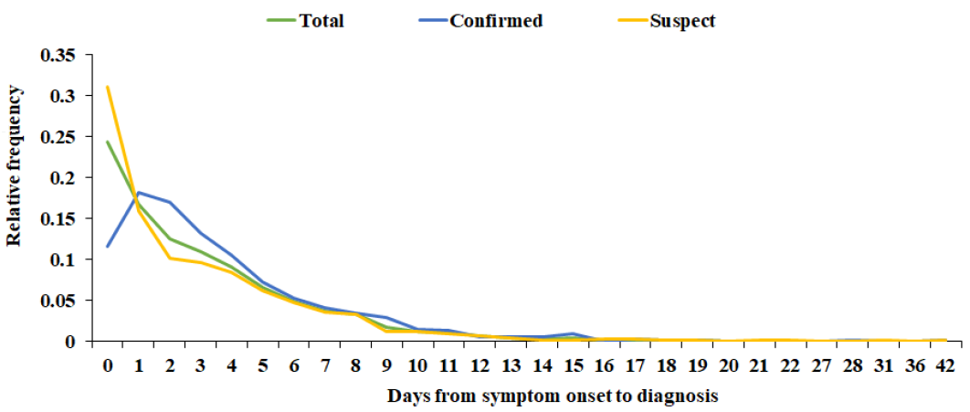
2,143 Pediatric COVID-19 Cases in China
Dong et al., Pediatrics. 2020; doi: 10.1542/peds.2020-0702; Advance Released March 16, 2020

Slide 18
SARS-CoV-2 Transmission
Based on knowledge of other coronaviruses (including SARS and MERS)
Person to person via respiratory droplets among close contacts
Within 6 feet of a patient with SARS-CoV-2 for a prolonged period of time
Having direct contact with infectious secretions from a patient with SARS-CoV-2 (sputum, serum, blood, respiratory droplets)
SARS-CoV-2 has been detected in stool, but clinical significance is unknown
https://www.cdc.gov/coronavirus/2019-ncov/hcp/faq.html

Slide 19
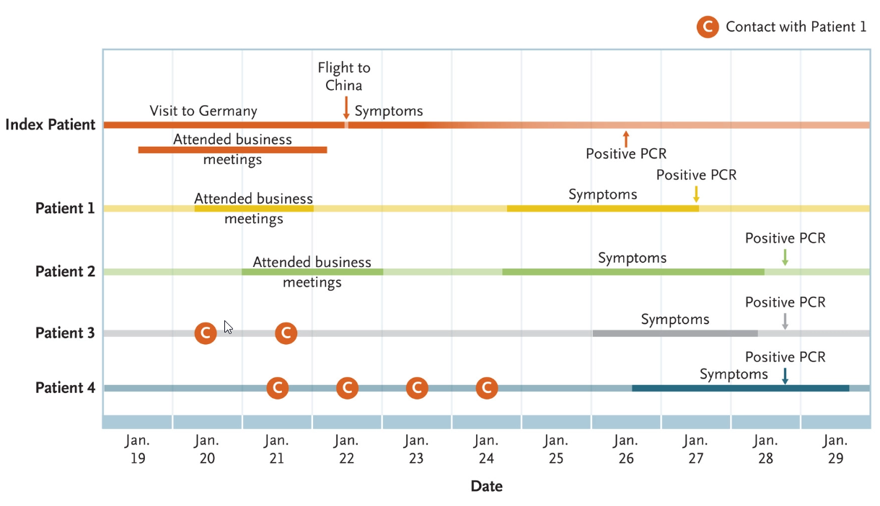
Asymptomatic Transmission of SARS-CoV-2
Rothe et al., N Engl J Med 2020; 382:970-971

Slide 20
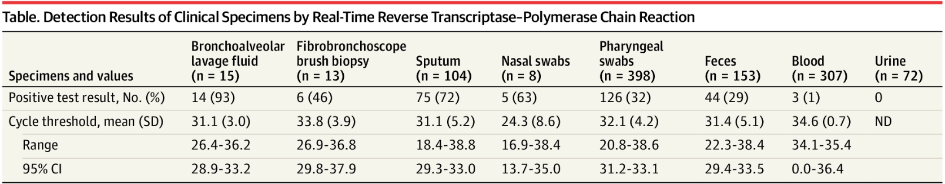
PCR Detection of SARS-CoV-2 1070 Specimens from 205 Patients (5-67 yrs)
Wang et al., JAMA. Published online March 11, 2020. doi:10.1001/jama.2020.3786

Slide 21
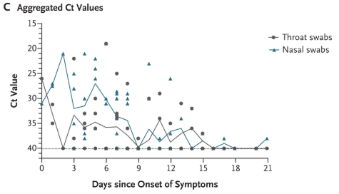
PCR Detection of SARS-CoV-2 144 Specimens from 18 Patients (26-76 yrs)
“The viral load that was detected in the asymptomatic patient was similar to that in the symptomatic patients”
Zou et al, NEJM
February 19, 2020 DOI: 10.1056/NEJMc2001737

Slide 22
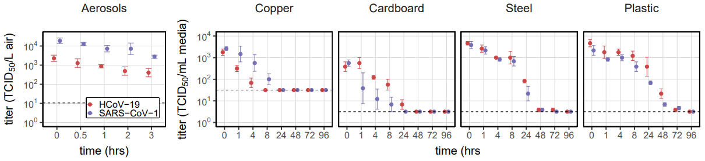
SARS-CoV-2 Stability in Environment
https://www.medrxiv.org/content/10.1101/2020.03.09.20033217v2.full.pdf
Van Doremalen et al, doi: https://doi.org/10.1101/2020.03.09.20033217

Slide 23
SARS-CoV-2 Stability in Environment
 | SARS-CoV-2
 | Half-life (hours)
Material | Median | 2.5% | 97.5%
Aerosols | 2.74 | 1.65 | 7.24
Copper | 3.4 | 2.4 | 5.11
Cardboard | 8.45 | 5.95 | 12.4
Steel | 13.1 | 10.5 | 16.1
Plastic | 15.9 | 13 | 19.2
https://www.medrxiv.org/content/10.1101/2020.03.09.20033217v2.full.pdf
Van Doremalen et al, doi: https://doi.org/10.1101/2020.03.09.20033217

Slide 24
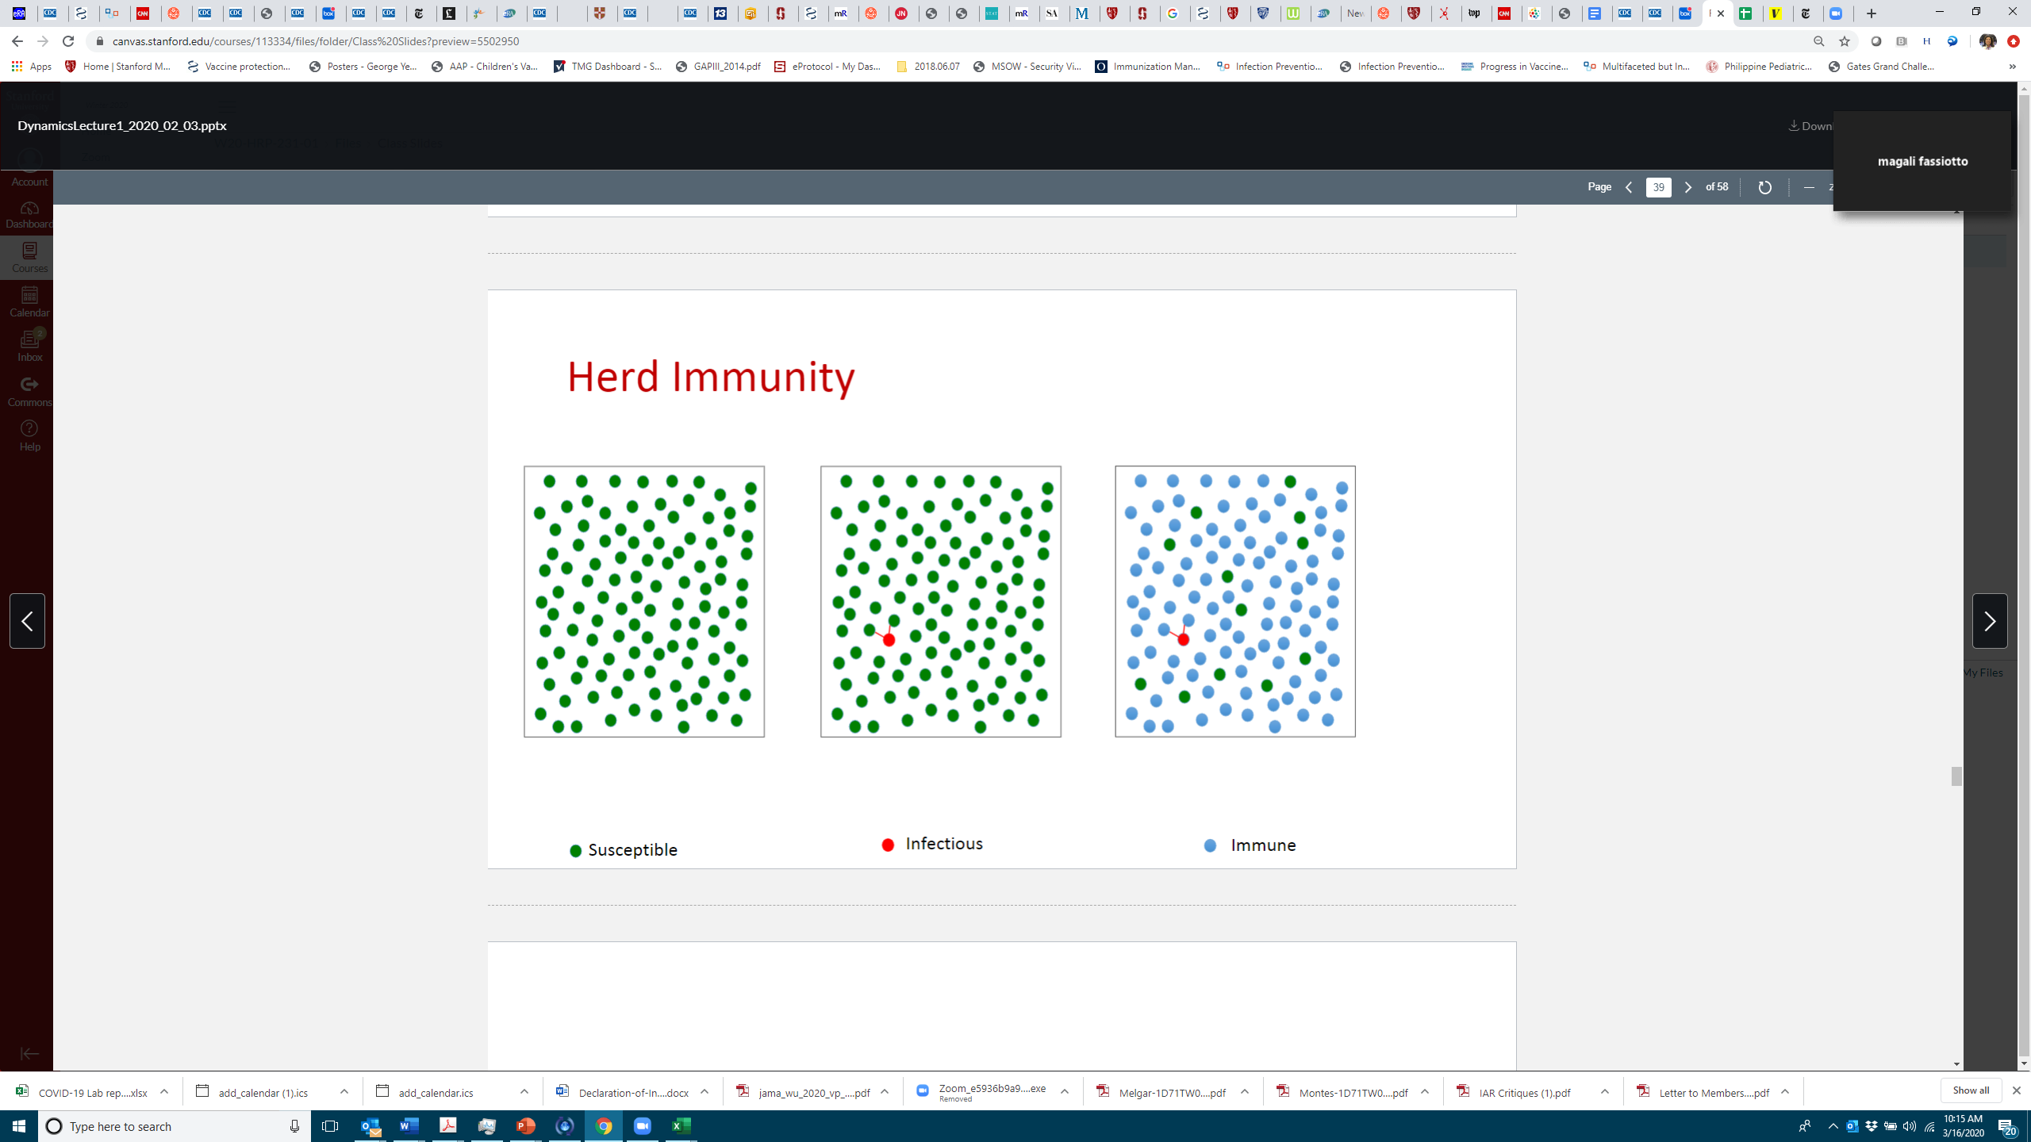
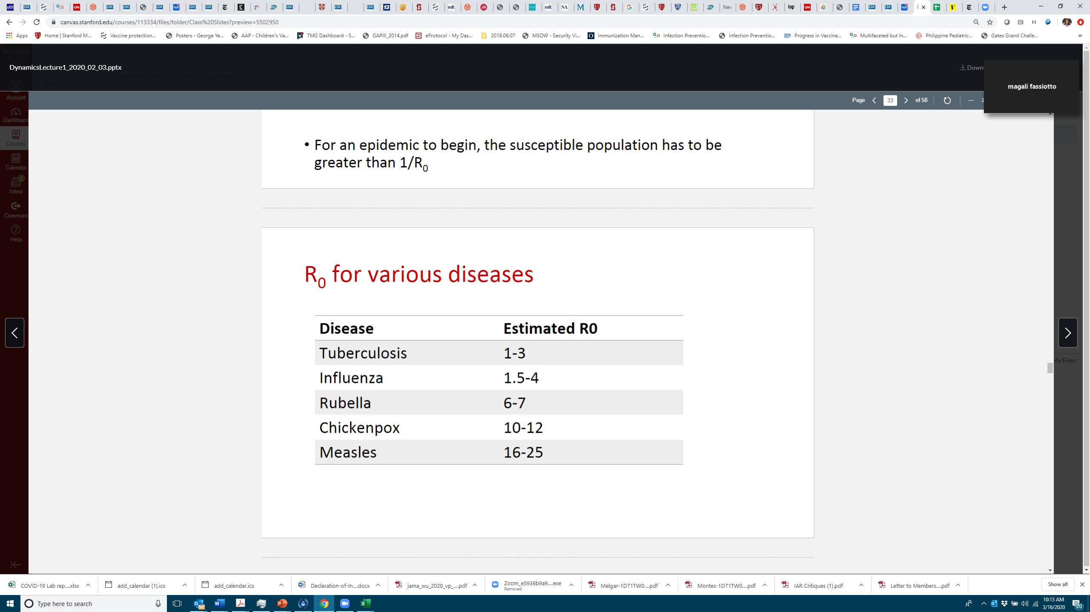
The susceptible fraction is the critical limiting factor to the start and stop of an epidemic
Final Epidemic Size
• No exact analytical solution
• Requires numerical solution

Slide 25
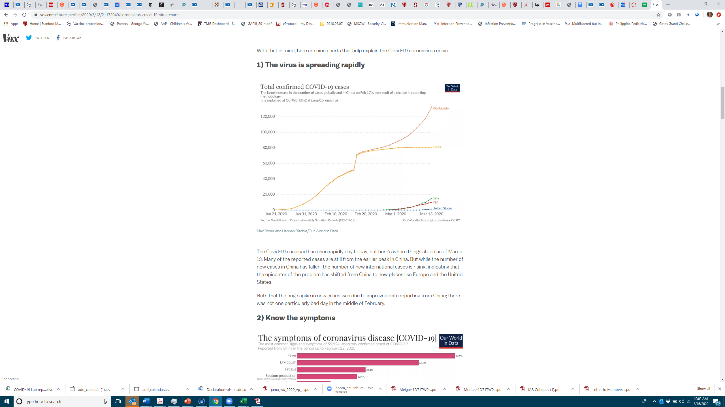
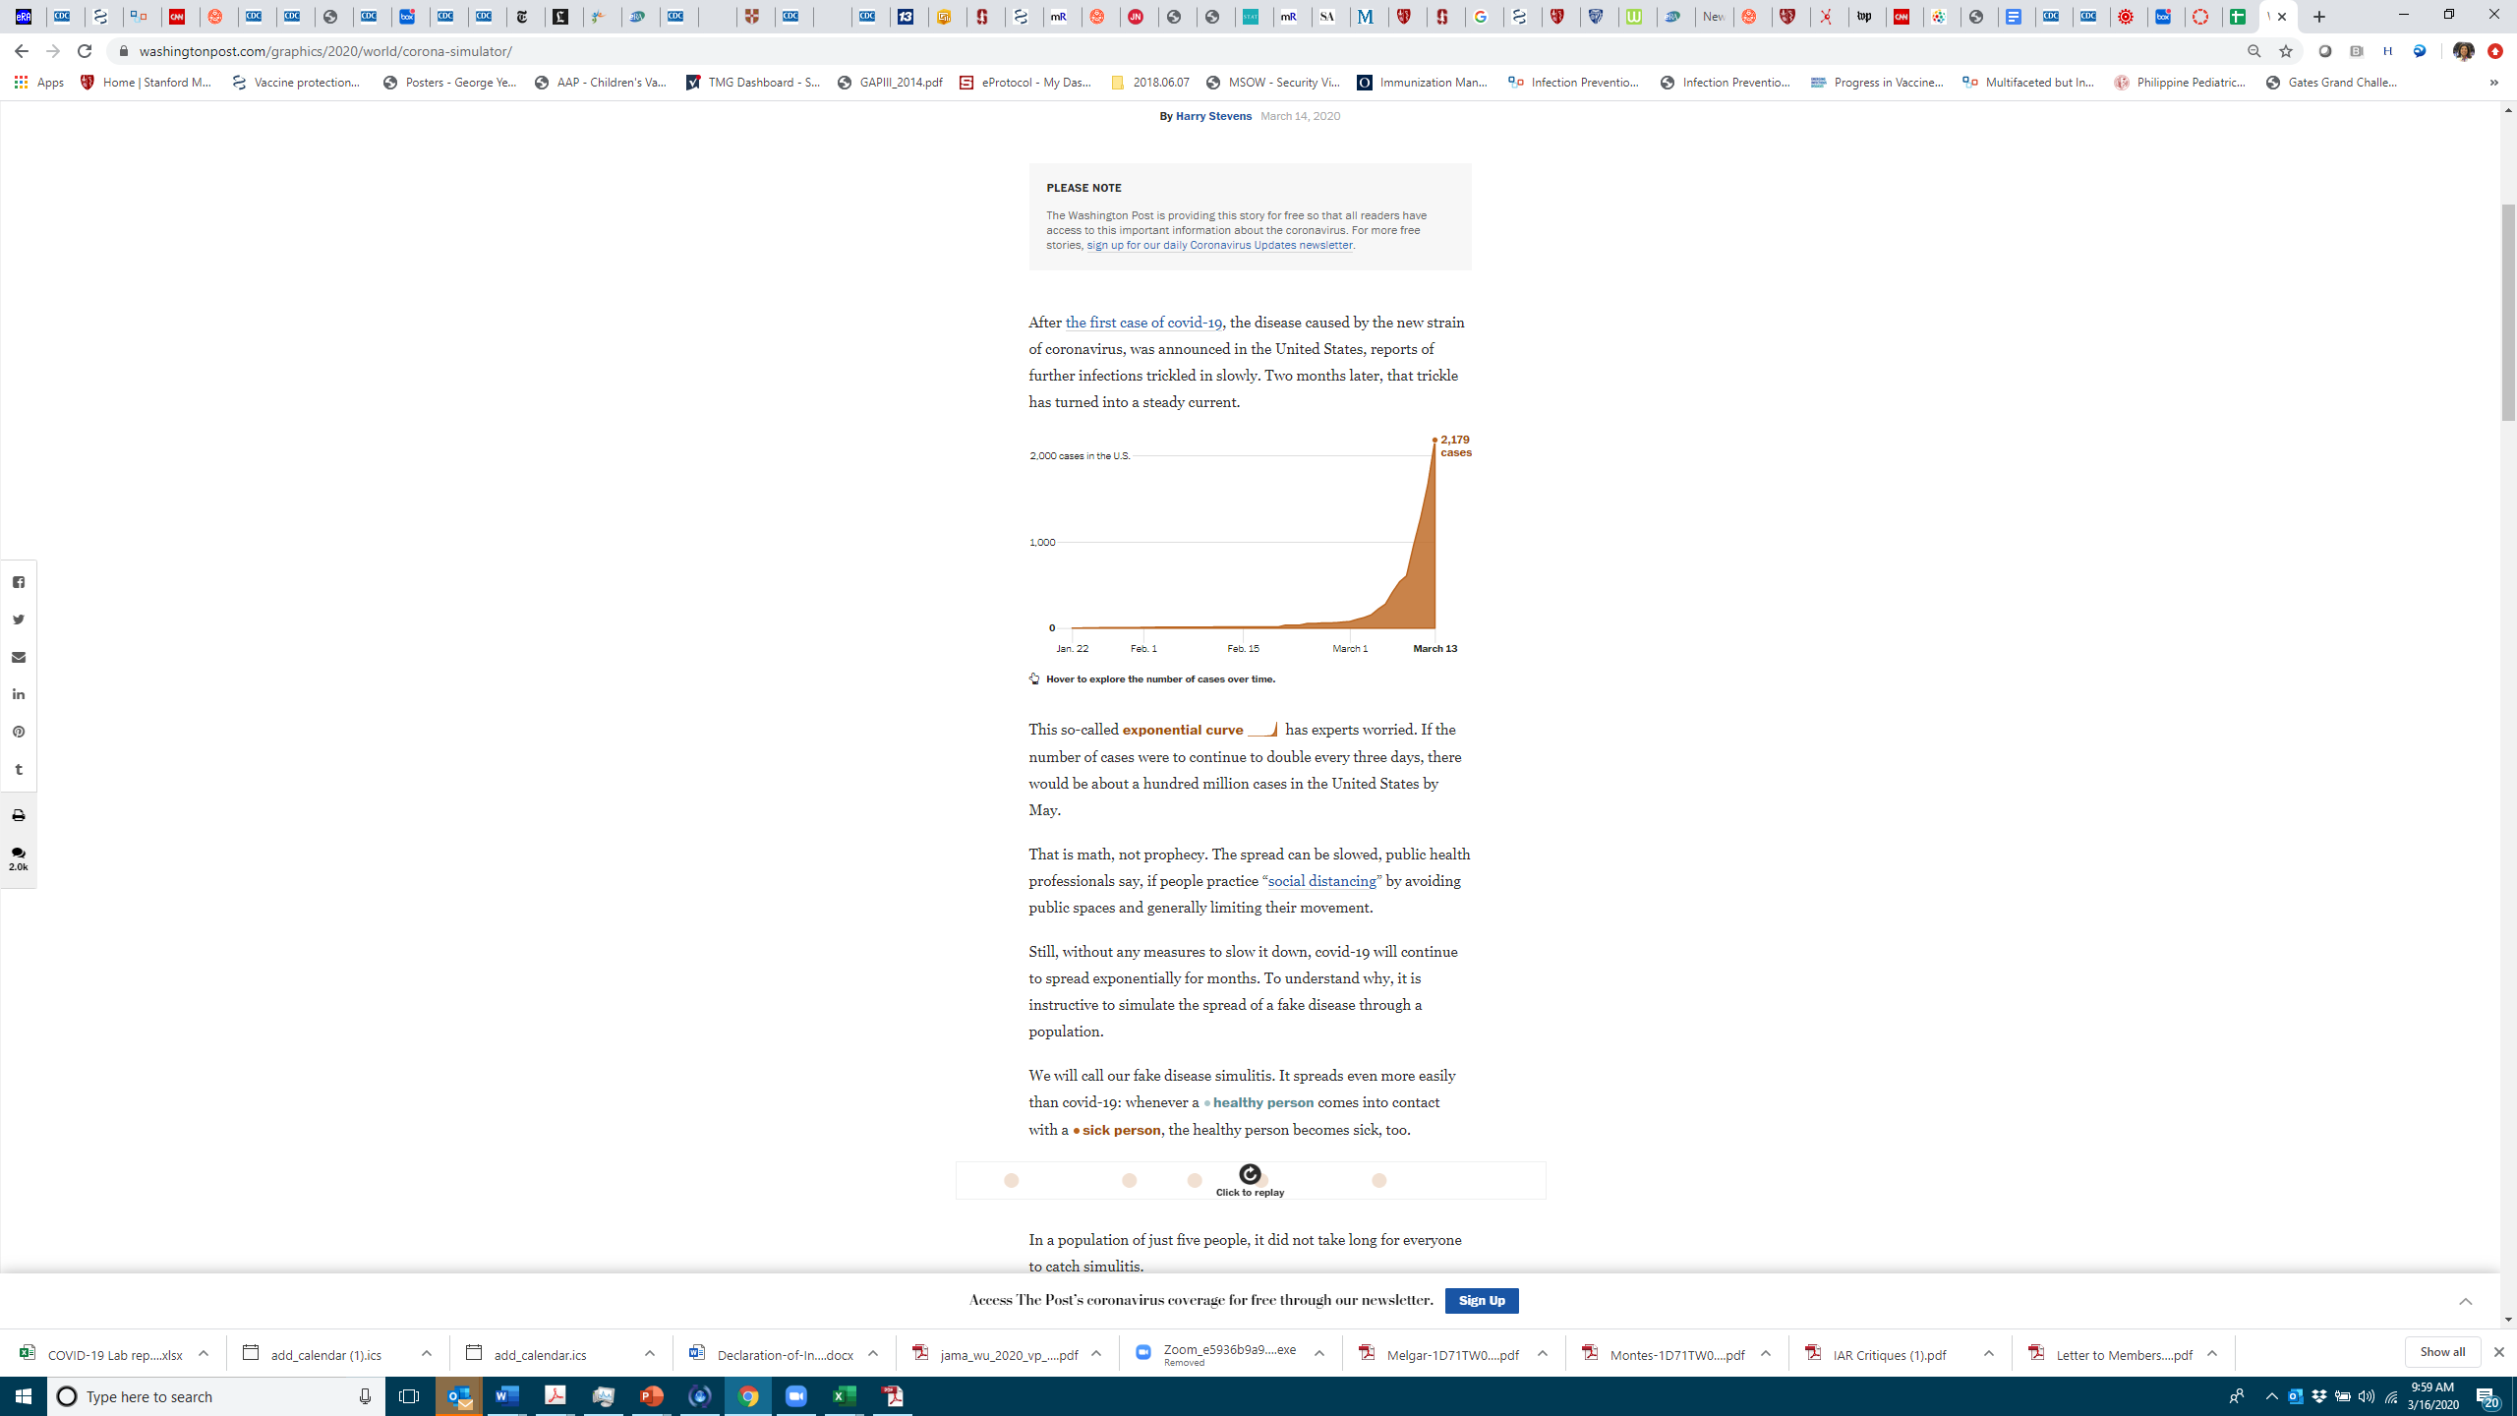
Epidemic Curve and Exponential Growth
https://www.vox.com/future-perfect/2020/3/12/21172040/coronavirus-covid-19-virus-charts
https://www.washingtonpost.com/graphics/2020/world/corona-simulator/

Slide 26
Resources:
CDC:
https://www.cdc.gov/coronavirus/2019-ncov/index.html
https://www.cdc.gov/coronavirus/index.html
WHO:
https://www.who.int/health-topics/coronavirus
Santa Clara County Public Health:
www.sccgov.org/sites/phd-p/Diseases/novel-coronavirus

Slide 28
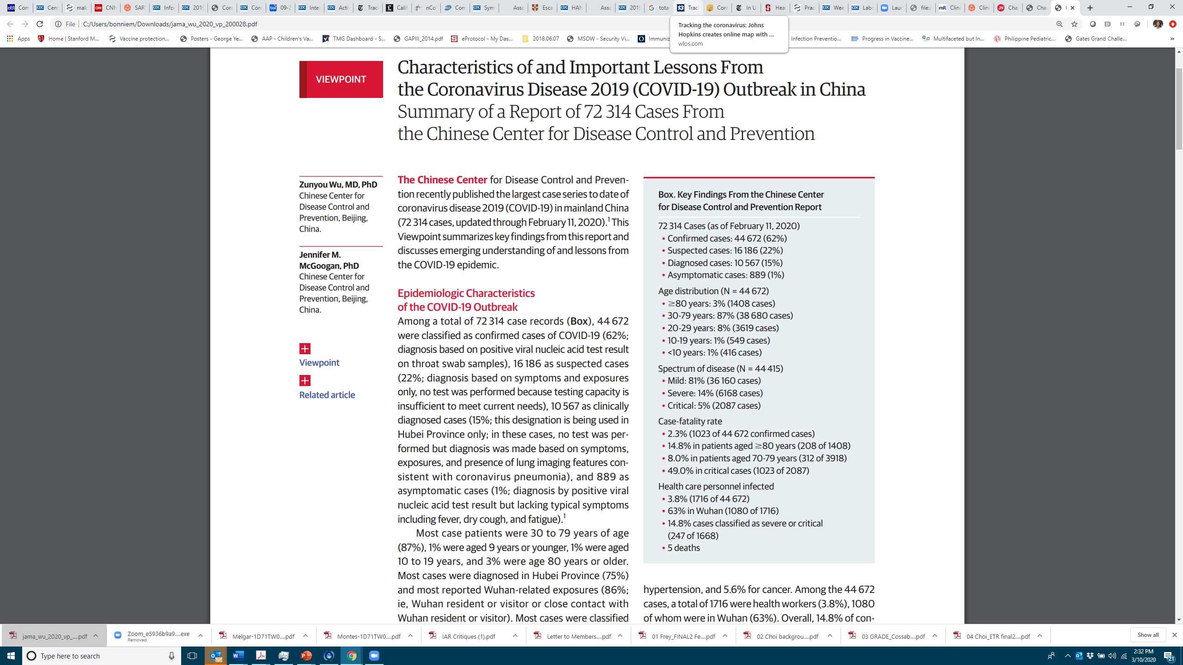
COVID-19 Experience in China
file:///C:/Users/bonniem/Downloads/jama_wu_2020_vp_200028.pdf

Slide 29
2,143 Pediatric COVID-19 Cases in China
Dong et al., Pediatrics. 2020; doi: 10.1542/peds.2020-0702; Advance Released March 16, 2020
Asymptomatic infection: No clinical symptoms and signs and the chest imaging is normal, but the SARS-CoV-2 PCR is positive.
Mild: Acute upper respiratory tract symptoms, including fever, fatigue, myalgia, cough, sore throat, runny nose, and sneezing. Physical examination shows congestion of the pharynx and no auscultory abnormalities. Some cases may have no fever, or have only digestive symptoms such as nausea, vomiting, abdominal pain and diarrhea.
Moderate: Pneumonia, frequent fever and cough (mostly dry, then productive), some may have wheezing, but no obvious hypoxemia such as shortness of breath, and lungs with rhonchi. Some cases may have no clinical signs and symptoms, but chest CT shows lung lesions.
Severe: Early respiratory symptoms such as fever and cough, may be accompanied by gastrointestinal symptoms such as diarrhea. The disease usually progresses around 1 week, and dyspnea occurs, with central cyanosis. Oxygen saturation is less than 92%, with other hypoxia manifestations.
Critical: Rapid progression to acute respiratory distress syndrome (ARDS) or respiratory failure, with or without shock, encephalopathy, myocardial injury or heart failure, coagulation dysfunction, and acute kidney injury. Organ dysfunction can be life threatening.

Slide 30
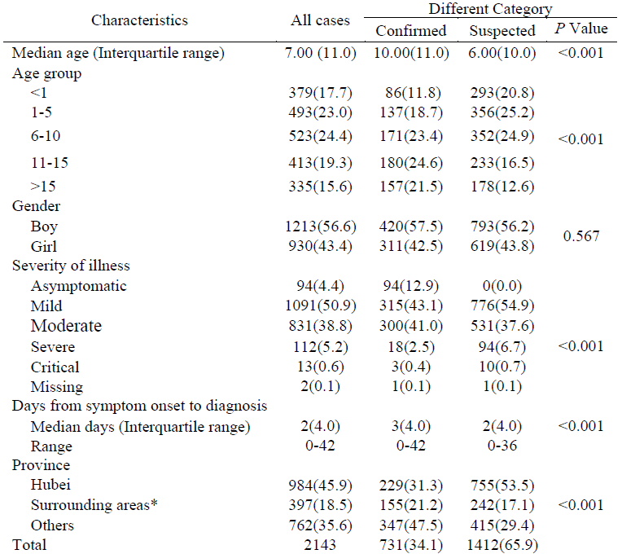
2,143 Pediatric COVID-19 Cases in China
Dong et al., Pediatrics. 2020; doi: 10.1542/peds.2020-0702; Advance Released March 16, 2020

Slide 31
Perinatal and Congenital Transmission
Perinatal transmission n=3 (by PCR)
In utero transmission n=3 (by IgM)

